Slide 1
Telematics & HPCC POC
March 2020
HPCC Innovation Lab
Dan camper
Bahar Fardanian

Slide 2
Connected cars
Millions of cars
Multiple journeys/day
Streaming data
Need fast analysis
Journey Data
General Telematics
Overview
Internet
Data Collection
Analysis

Slide 3
Python code
Simulated
Journey Data
HPCC-based POC
Overview
Internet
Kafka
HPCC
Cluster

Slide 4
Keywords
Kafka Node : Apache Kafka Server
Messenger node : Python threads pushing stream of test Data to Kafka
HPCC : Analyzing journeys
Journey : car trip
Waypoint : Data snapshot within a journey
Message : string representation of a journey
Message life : number of seconds between creation and process of a journey
Batch Size : max number of messages in a timed job
Notes:
Kafka Node: Apache Kafka server, open source, real time, stream processing platform. Used to publish and subscribe to stream of records.
Journey: A car’s trip from Point A to Point B
Message: A string representation of all the data that makes up a journey
Message Life: The number of seconds between when a Message is first created and when it has been fully processed by HPCC
Waypoint: Data snapshot from a point in time during a Journey; contains location data, vehicle speed, etc.
Batch Size: The maximum number of Messages that can be read from Kafka during a period Thor job

Slide 5
Simulation Process
Project includes three steps
Data Simulation
Apache Kafka server
HPCC System

Slide 6
Data simulation
Collection of free data
Original size was about 1.2M journeys
Data was duplicated to create about 4m journeys
Each journey Made unique using new vehicle ID values

Slide 7
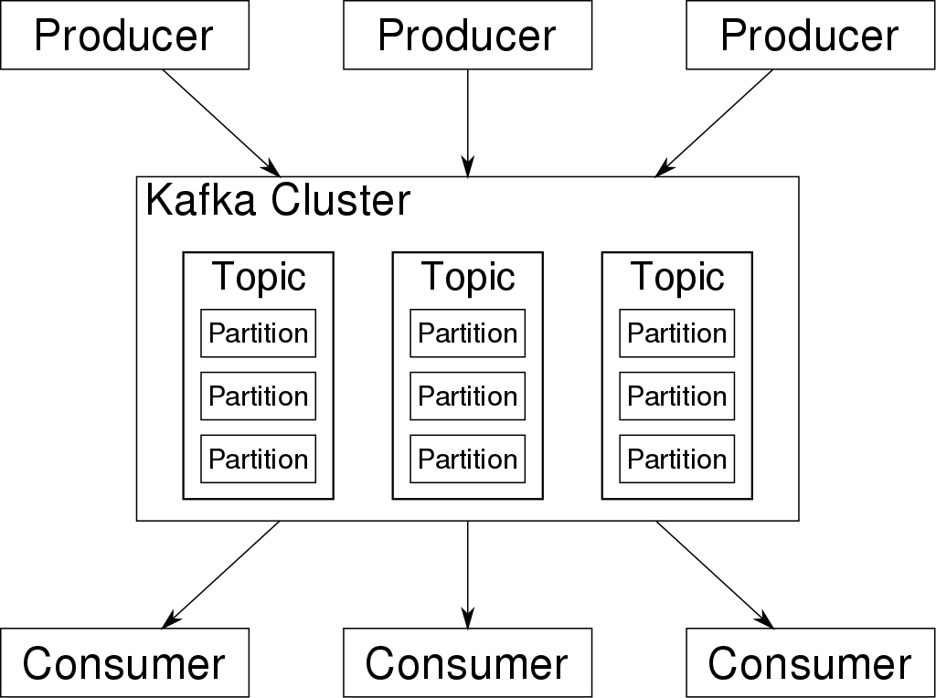
Apache Kafka (streaming process)
Kafka accepts real-time data from producers and stores it in serialized logs.
Notes:
“Kafka accepts real-time data from multiple producers and stores it in serialized logs. Consumers, such as HPCC Thor Slave processes, then retrieves that data from separate streams”
Kafka accepts real-time data from multiple producers and stores it in serialized logs.
Kafka passively listens to incoming data
Python workers/threats are pushing the data to Kafka – producers are python threads.
HPCC pulls the data from Kafka on a schedule/ Cron job --- Consumer
Extra:
One kafka topic called telematics, each thor slave is talks to a partition.
HPCC can’t handle stream, kafka is collecting individual messages so HPCC can pull them processes them as a batch

Slide 8
Hpcc system
Fetches Messages from KAFKA’s Telematics topic
Parses messages/Journeys to required format
Performs calculations on messages (hard brake and hard acceleration)
Saves results to files

Slide 9
HPCC POC Architecture
Pulls Journeys Periodically
ECL
Python
Thread
Parse & Save
Message
Queue
Push
Datasets
Dataset
Python
Thread
Telematics Data
File
Data is
Time Stamped
Analyze & Save
Result
Python
Thread
HPCC
Kafka
Telematics Simulator Client

Slide 10
Initially
Cron job can handle maximum of 64,552 journeys per minute with current infrastructure.
Kafka Offset | Batch Size | Thor Time | Min Msg Len | Max Msg Len | Avg Msg Len
 | 60000 | 0:58 | 242 | 307096 | 42773.33
 | 65000 | 1:6 | 170 | 275493 | 43998.44
 | 66000 | 1:6 | 235 | 357123 | 43689.35
 | 1,000,000 | 14:57 | 171 | 320608 | 40959.45
 | 2,000,000 | 33:48 | 161 | 577874 | 45327.56
Y | 6000 | 7.7 | 1331 | 117536 | 44509.13
Y | 1000,000 | 19:06 | 161 | 577874 | 51908.82
Y | 2000,000 | 33:38 | 161 | 577874 | 45327.56
Average | 774625 | 12:10 | 329 | 388934.8 | 44811.71
Notes:
Kafka already have a bunch of message
No msg are being sent live.
Mesg size gives us an idea about the amount and shape of data.

Slide 11
HPCC – end to end live
5 ec2
8 Node thor slave
m5a.2xlarge (8 CPU and 32G memory)
us-east-2c - Ohio
Linux
Overall Average : 41,326
Journeys Per Min | CronJob | Batch Size | Journeys | Avg Life (Sec)
40,901 | 1 Min | 50K | 1063435 | 223.3846
43,366 | 1 Min | 50K | 3989735 | 68.18539
45,045 | 1 Min | 60K | 4189239 | 71.88459
37517 | 1Min | 60K | 1313124 | 65.57601
42,588 | 1 Min | 110K | 4344063 | 272.5811
37517 | 1Min | 110K | 2740751 | 63.97145
43,233 | 2Min | 110K | 4236886 | 121.0954
41,957 | 5 Min | 300K | 4195731 | 314.5471
Notes:
Python sending live msg, and HPCC consuming them, this let us figure out the msg life.
SLA of 2-3 min

Slide 12
KAFKA & Messenger Infrastructure
2 ec2
m5a.2xlarge (8 CPU and 32G memory)
us-east-2c – Ohio
Linux
# Workers | Load Avg 1 | Load Avg 2 | Load Avg 3 | Load Avg 4 | Total Average
2 | .77 | .93 | .83 | 1.09 | 1.09
3 | 1.03 | .91 | 1.00 | 1.18 | 1.03
4 | 1.16 | 1.38 | 1.36 | 1.21 | 1.27
Notes:
Load avg displays how busy CPU, disk and other processes are.
With 8 cores, on the system there is a lot of room to grow. Load avg should never pass 8.
#workers 4 pn python side, every worker is actually 2 => so 4 is 4*2 + python itself/// so we maxed the capacity.
Every python worker is a thread and spawns a theard to talk to Kafaka
We maxed out messenger node and kafka node can handle it*********

Slide 13
horizontal scale - Budget
Messages are saved on DISK
80% process increase (based on complexity, msg size, combination)
EC2 | CPU | MEMORY | Storage | Location | Operating System | Number of slave ec2 | Monthly Cost | #Journeys / Min
m5a.2xlarge ($ 291.81) | 8 | 32G | 400 GB | US EAST OHIO | LINUX | 4 | $ 1,167.24 | 41k
m5a.2xlarge | 8 | 32G | 400 GB | US EAST OHIO | LINUX | 16 | $ 4,668.96 | 131K
m5a.2xlarge | 8 | 32G | 400 GB | US EAST OHIO | LINUX | 64 | $ 18,675.84‬ | 525K
Notes:
This is just for POC….
On demand
IOPS of 1200, measuring of input/output operations per seconds. 1200 is the default. The operations are measured in KiB,

Slide 14
Challenges
Number of node
Cron Intervals Pick time
Communication between HPCC and Kafka
Sla
Sample file
Notes:
Sample file only has location, in reality a msg has a lot more data per waypoint

Slide 15
future Thoughts
different infrastructure setups
Scale vertically or horizontally
Real / production data
Stress test
Transfer to Azure (we don’t foreseen major changes)

Slide 16



